Slide 1
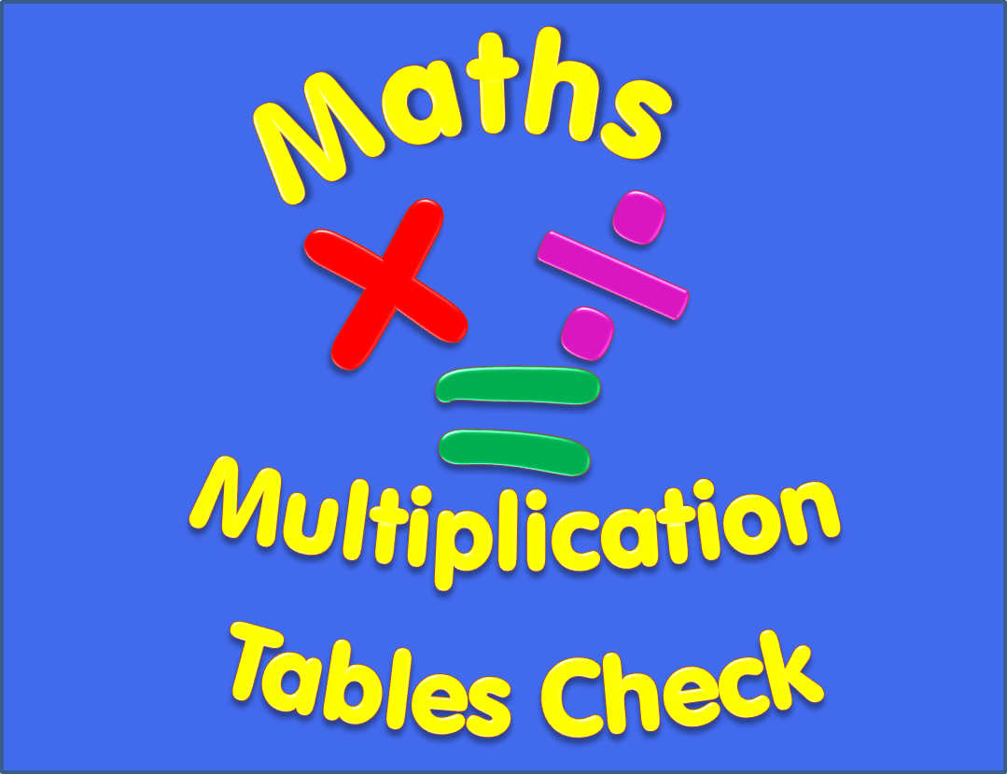

Slide 2
Begin
Instructions
There are 25 multiplication questions on any times table from 2 to 12.
Each multiplication question will appear on the screen for 6 seconds. There will then be a 3 second break before the next question appears.
Good Luck!

Slide 3
6 x 10
Q1

Slide 4
7 x 7
Q2

Slide 5
3 x 5
Q3

Slide 6
2 x 6
Q4

Slide 7
4 x 3
Q5

Slide 8
5 x 12
Q6

Slide 9
9 x 6
Q7

Slide 10
5 x 9
Q8

Slide 11
12 x 9
Q9

Slide 12
11 x 8
Q10

Slide 13
9 x 3
Q11

Slide 14
12 x 12
Q12

Slide 15
3 x 11
Q13

Slide 16
11 x 11
Q14

Slide 17
7 x 12
Q15

Slide 18
10 x 7
Q16

Slide 19
8 x 6
Q17

Slide 20
6 x 6
Q18

Slide 21
12 x 11
Q19

Slide 22
10 x 8
Q20

Slide 23
8 x 2
Q21

Slide 24
8 x 9
Q22

Slide 25
12 x 10
Q23

Slide 26
7 x 9
Q24

Slide 27
8 x 5
Q25

Slide 28
Completed!
All multiplication questions have now been shown.
To find out your score click on the button below.
Answers

Slide 29
Answers
1) 6 x 10 = 60 2) 7 x 7 = 49 3) 3 x 5 = 15
4) 2 x 6 = 12 5) 4 x 3 = 12 6) 5 x 12 = 60
7) 9 x 6 = 54 8) 5 x 9 = 45 9) 12 x 9 = 108
10) 11 x 8 = 88 11) 9 x 3 = 27 12) 12 x 12 = 144
13) 3 x 11 = 33 14) 11 x 11 = 121 15) 7 x 12 = 84
16) 10 x 7 = 70 17) 8 x 6 = 48 18) 6 x 6 = 36
19) 12 x 11 = 132 20) 10 x 8 = 80 21) 8 x 2 = 16
22) 8 x 9 = 72 23) 12 x 10 = 120 24) 7 x 9 = 63
25) 8 x 5 = 40

